Slide 1
James 4:7-10, 13-17
7 Submit yourselves, then, to God. Resist the devil, and he will flee from you. 8 Come near to God and he will come near to you. Wash your hands, you sinners, and purify your hearts, you double-minded. 9 Grieve, mourn and wail. Change your laughter to mourning and your joy to gloom. 10Humble yourselves before the Lord, and he will lift you up.

Slide 2
James 4:7-10, 13-17
13Now listen, you who say, "Today or tomorrow we will go to this or that city, spend a year there, carry on business and make money." 14Why, you do not even know what will happen tomorrow. What is your life? You are a mist that appears for a little while and then vanishes. 15Instead, you ought to say, "If it is the Lord's will, we will live and do this or that." 16As it is, you boast and brag. All such boasting is evil. 17Anyone, then, who knows the good he ought to do and doesn't do it, sins.

Slide 4
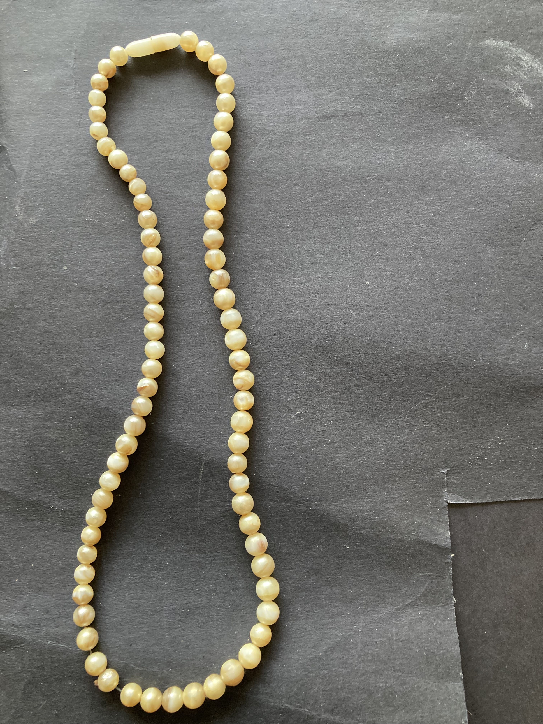
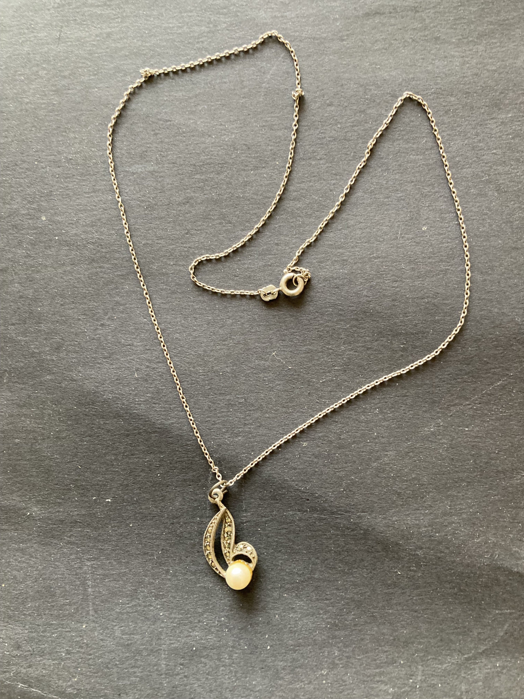
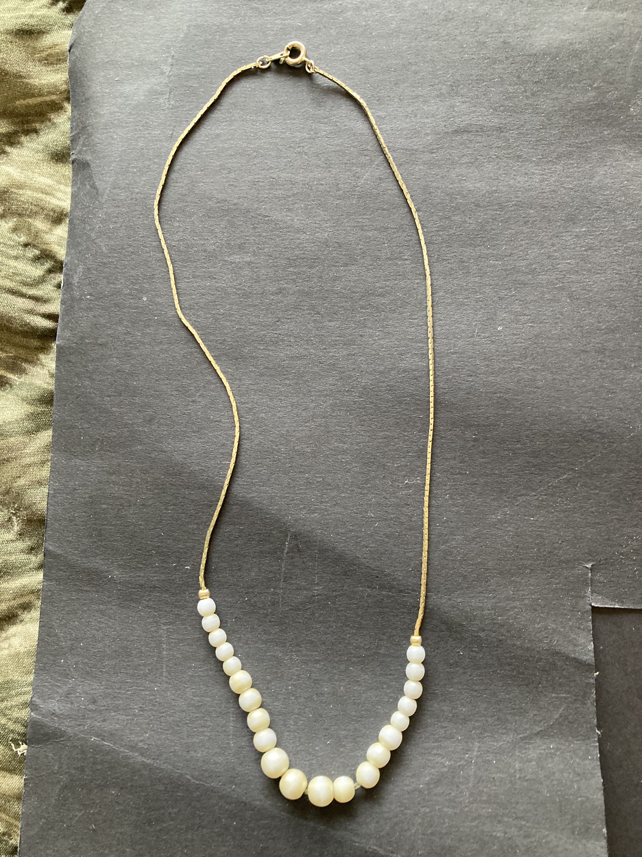
Pearls
1
2
3
4
1

Slide 5
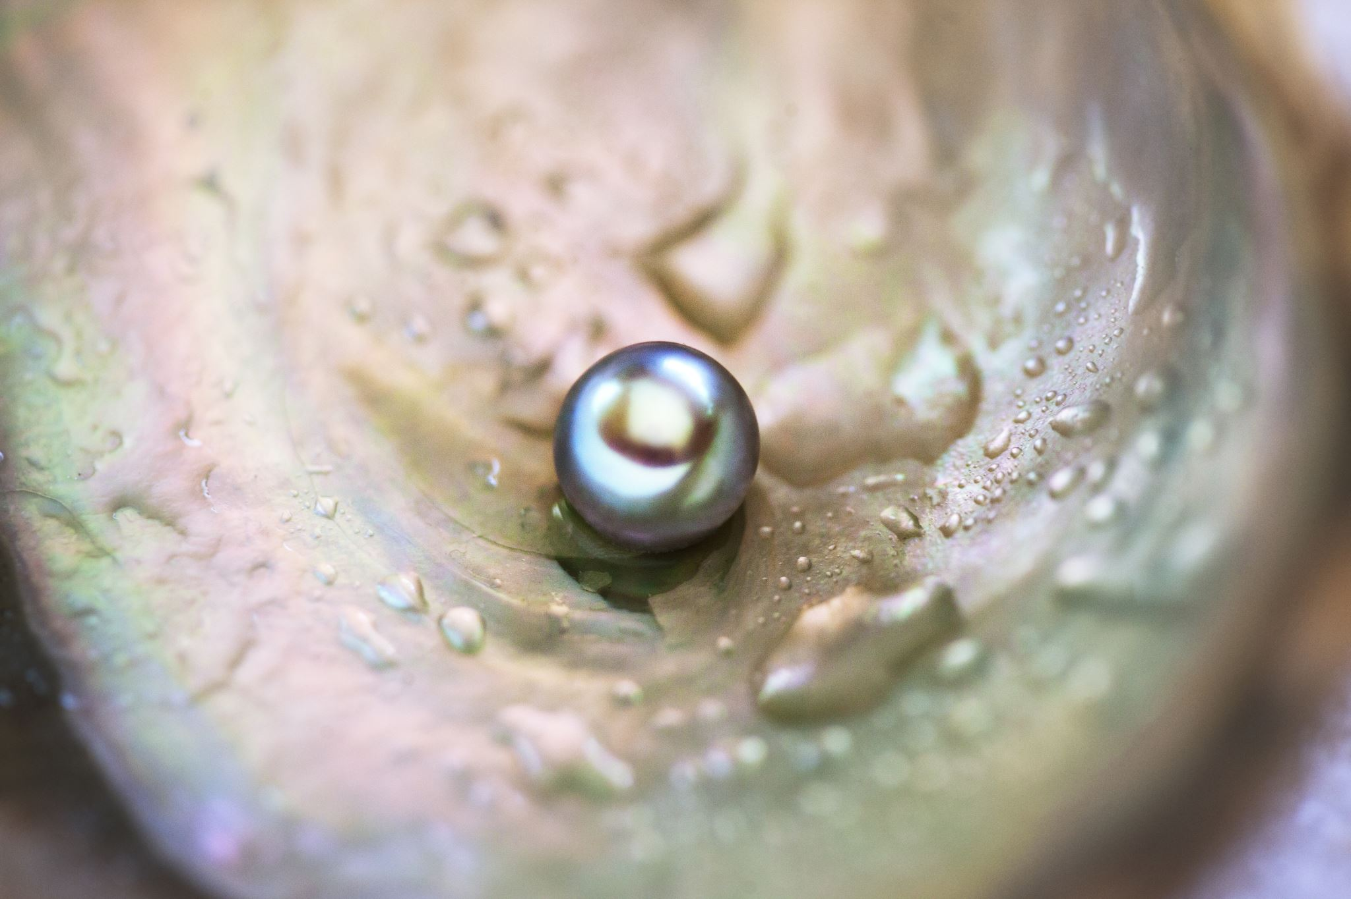
Pearls from James
September:
11th – Sue de Pyle – James 1:19-27
18th – Woody Baker – James 2:1-13
25th – Woody Baker– James 2:14-26
October:
2nd – Kay Brown – James 4:1-17
9th – Tania Hannath – James 3:1-12
16th – Tom Kenneally - James 3:13-18
23rd – Kay Brown – James 5:13-20

Slide 6
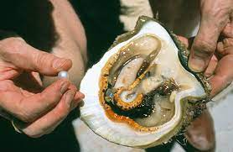
Pearls from James
September:
11th – Sue de Pyle – James 1:19-27
18th – Woody Baker – James 2:1-13
25th – Woody Baker– James 2:14-26
October:
2nd – Kay Brown – James 4:1-17
9th – Tania Hannath – James 3:1-12
16th – Tom Kenneally - James 3:13-18
23rd – Kay Brown – James 5:13-20

Slide 7
Pearls from James
October 2nd
Kay Brown
James 4:1-17
Submitting to God
Boasting about tomorrow

Slide 8
Pearls from James
James 4:1-17
Irritation James 4:1-6
Fights, Quarrels, Killing, Coveting, Wrong motives,
Craved Wealth, Friendship with the World,

Slide 9
Pearls from James
James 4:1-17
Irritation James 4:1-6
Fights, Quarrels, Killing, Coveting, Wrong motives, Craved Wealth, Friendship with the World,
Outcome
Broken relationships, Insecurity

Slide 10
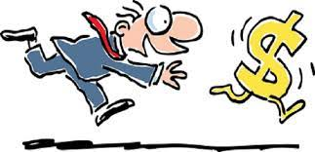
Pearls from James
James 4:1-17
Irritation James 4:1-6
Fights, Quarrels, Killing, Coveting, Wrong motives, Craved Wealth, Friendship with the World,
Outcome
Broken relationships, Insecurity

Slide 11
Pearls from James
James 4:1-17
CS Lewis sums it up in Mere Christianity
Give yourself up, and you will find your real self.
Lose your life and you will save it…
Look for yourself and you will find in the long run only hatred, loneliness, despair, rage, ruin and decay.
But look for Christ and you will find him, and with him everything else thrown in!

Slide 12
Pearls from James
James 4:1-17
God’s Answer James 4: 7-10
True Submission
Resisting the devil
Drawing near to God
Washing our hands
Purifying our hearts
Sorrow

Slide 13
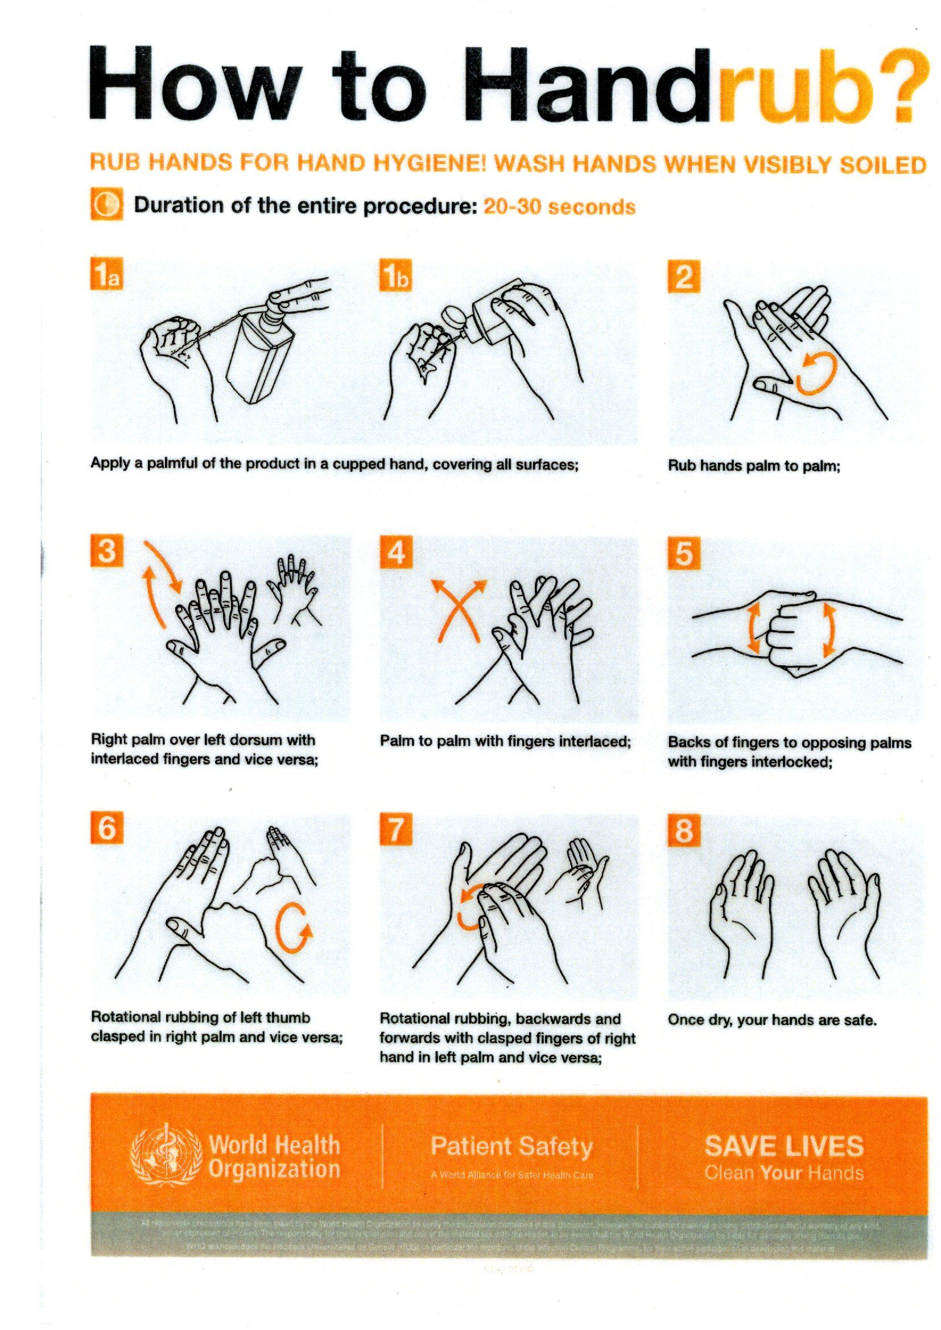
Think about what we are doing
Deliberate act for cleansing

Slide 14
Pearls from James
James 4:1-17
God’s Answer James 4: 7-10
True Submission
Resisting the devil
Drawing near to God
Washing our hands
Purifying our hearts
Sorrow

Slide 15
Pearls from James
James 4:1-17
God’s Answer James 4: 7-10
True Submission
Resisting the devil
Drawing near to God
Washing our hands
Purifying our hearts
Sorrow
Humble yourself before the Lord and He will
lift you up

Slide 16
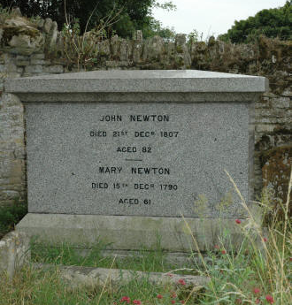
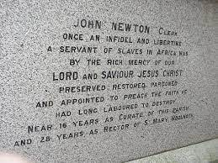
Pearls from James
James 4:1-17

Slide 17
Pearls from James
James 4:1-17
James 4:13-17
Merchants - riding a crest of materialism and decadence, arrogant , picture of the mist appearing and disappearing

Slide 18
Pearls from James
James 4:1-17
James 4:13-17
Merchants - riding a crest of materialism and decadence, arrogant , picture of the mist appearing and disappearing
God’s Answer
“If it is the Lord’s will , we will live and do this or that”

Slide 19
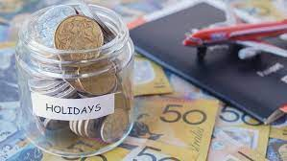
Pearls from James
James 4:1-17

Slide 20
Pearls from James
James 4:1-17
If it is the Lord’s will

Slide 21
Pearls from James
James 4:1-17
Is there an irritation in your life right now that is producing a pearl?
Are you submitting to God? 4:7-10
What drives you each day, what is your focus?
Is it the Lord’s will ?

